Slide 1

ConnectTel Customer Churn Prediction
Capstone Case Study
by moses@10alytics.io
May 2024

Slide 2
Contents
Problem Overview
Project Objective
Dataset
Data Preprocessing
Visualization
ML Implementation
ML Evaluation Metrics
Confusion Matrices
Conclusion

Slide 3
Overview
ConnectTel is a leading telecommunications company
They are faced with customer churn challenges
Current strategies are not working
They wish to overcome this challenge by implementing state of the art churn prediction system
Leveraging advanced analytics and machine learning techniques
To enhance customer loyalty and maintain a competetive edge in the industry

Slide 4

Project Objective
Unearth insights from the data provided
Develop the most effective machine learning model that accurately predicts customer churn

Slide 5
Dataset
ConnectTel customer data required to carry out analytics and predictions was provided by 10Alytics
The dataset contains minimal customer features and the telecommunications services they have subscribed to
It also contains specific information on the customers’ loyalty status which confirms if they have churned or not

Slide 6
Data Preprocessing
Extensive data analysis and preprocessing steps were carried out
This helped to identify missing values and incorrect attribute specification
The identified issues were corrected by
Replacing missing values with zeroes
Correcting “TotalCharges” attribute data type: from object to float

Slide 7
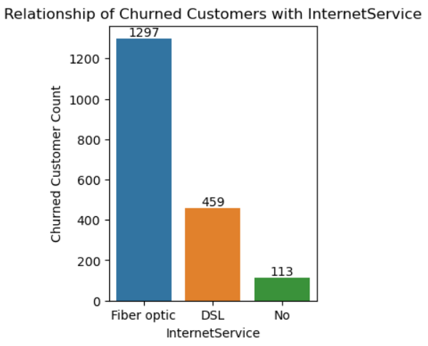
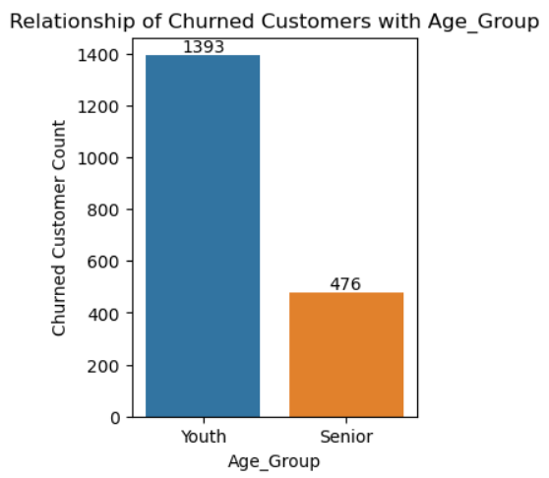
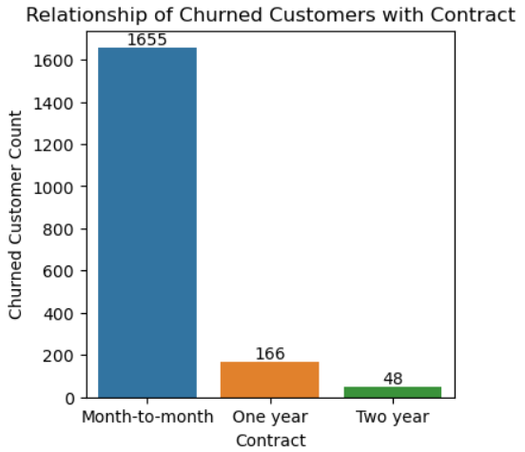
ViSualizations
Univariate, bivariate and multivariate analyses were carried out and great insights were revealed, such as:
74% of churned customers are youths
88% of churned customers are on month-to-month contract
69% had subscribed to fiber optic internet service

Slide 8
MACHINE LEArning Implementation
The implementation was carried out using the following classification algorithms after splitting the data into training and test dataset in the ratio 7:3
XGBoost
Logistic Regression
Decision Tree
Random Forest
K-Nearest Neighbors
Naives Bayes
Support Vector Classifier
Linear SVC
SGD
Different encoders and scalers were successfully iterated during the data preparation phase to obtain the best-performing models and I finally settled for OneHotEncoder and StandardScaler
Notes:
The process was simplified with the aid of automation/for-loops
Several iterations were carried out using different encoders (label and ordinal, and onehotencoder)
Similarly, standardscaler, minmaxscaler and robustscaler
Stochastic Gradient Descent

Slide 9
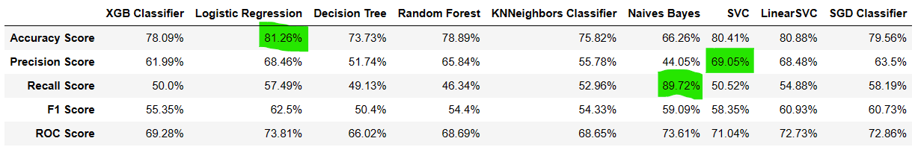
ML Evaluation Metrics
Logistic Regression model has the highest accuracy score of 81.26%
SVC model has the highest precision score of 69.05%
Naives Bayes has the highest recall score of 89.72%
What is the most important metric to consider?
Notes:
Dataset is biased

Slide 10
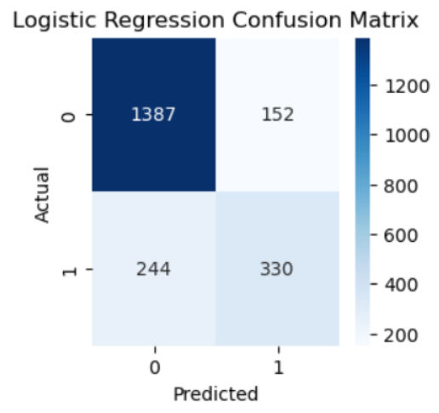
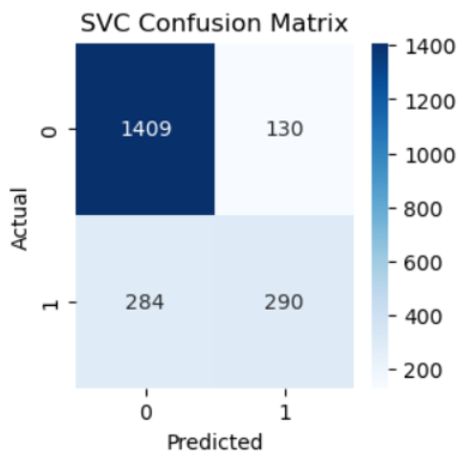
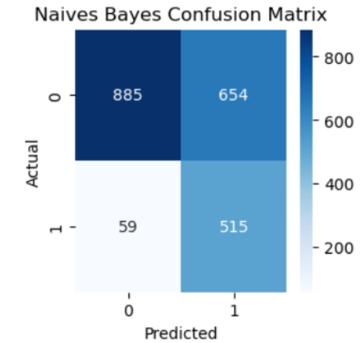
Churn Prediction – Confusion Matrices

Slide 11
Conclusion
The business is most interested in cutting down customer churn. Better TP results will enable it to target most customers that will churn.
The best-performing model in predicting the likelihood of churn (more TPs) when used on the test data will be most suited to satisfy the requirement.
This means the recall score will be the basis for selecting the most appropriate model
This makes Naives Bayes the best model with a recall score of 89.72%
Notes:
TP/(TP+FN)

Slide 12

Thank you

